Slide 1


Routing and Navigation

Slide 2
Routing and Navigation
SAPUI5 provides routing and navigation capabilities which allows user to navigate between various pages and views.
SAPUI5 offers hash-based navigation, which allows you to build single-page apps where the navigation is done by changing the hash.
the method of routing involves determining which views or pages should be displayed in response to the specific url.
Routing can be used for,
navigation to different views
enable bookmark and deep links to page inside the app
pass the data via the hash to application logic
In SAPUI5, the Router class is used to control routing and navigation. The responsibility of the Router class is to parse the URL, match it to a route, load the corresponding view, and then show it
In SAPUI5, navigation and routing is implemented using a “router” to forward the hash change and the data in the hash to one or more views of the app.

Slide 3
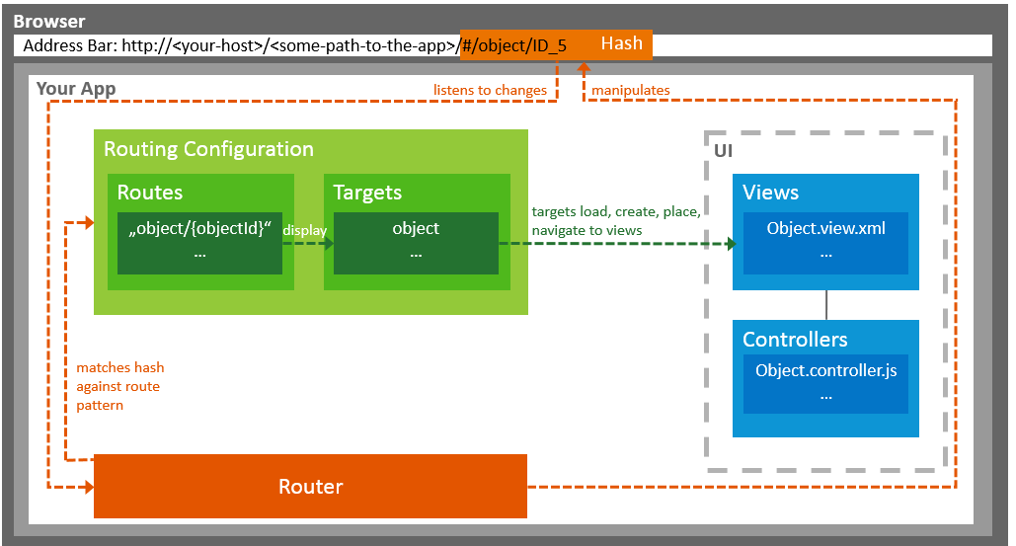
Routing and Navigation

Slide 4
Routing Terms
Routes : used to notify your application that the hash has changed to a certain value. It is a array that contains the individual routes.
Target : used to define where a view or a component is loaded and where the view or component is shown on the UI.
Patterns : used to checks whether there is a route with a matching pattern. The first matching route is taken, and the corresponding target view is called. The 1st matching pattern is always a empty string which refers to a default route.
You can use the following kinds of patterns:
Hard-coded pattern: ex - product/settings
Route with mandatory parameter: Ex- product/{id}
Route with optional parameter:product/{id}/detail/:detailId:
Route with query parameter: (product/{?query}) or optional {product/:?query:}

Slide 5
Routing Configuration
Routing configuration consist of routes, targets and config
Config : config section contains the global router configuration and default values that apply for all routes and targets.
routerClass defines which router is used.
async defines whether targets are loaded asynchronously
Viewtype , viewpath and controlId
Routes : Each route defines a name, a pattern, and optionally one or more targets to which to navigate when the route has been matched
The name of the route (unique within one router instance)
The pattern as hash part of the URL that matches the route
The navigation target as defined in the targets section
Target : A target defines the view or component that is displayed. The target definition can contain the following parameters:
viewType (e.g. XML) which is valid only when the type is set to "View"
id of the view or component instance
clearAggregation specifies whether the aggregation should be cleared before adding the new view instance.
transition defines how the transition happens; you can choose between slide (default), flip, fade, and show.

Slide 6
Methods and Events
SAPUI5 provides a method and events for navigation.
Methods : this method is used to navigate to the given route and fill the hash with the corresponding data. If the route contains a target, the target is displayed.
var oRouter = this.getOwnerComponent().getRouter();
oRouter.navTo("product", { id: "5", productId: "3" });
Events: The routePatternMatched event is fired if a pattern of any route in the routing configuration is
matched. The events have the following parameters:
name of the route that has been matched
arguments that are part of the route, mainly the parameters of the hash
config of the route The methods attachRouteMatched and attachMatched can be used to attach an event listener to these events
The methods attachRouteMatched can be used to attach an event listener to these events.

Slide 7
Initialization and Accessing Instance
The router can be initialized in component.js file
init: function ()
{ ... // call the init function of the parent
UIComponent.prototype.init.apply(this, arguments);
// this component should automatically initialize the router
this.getRouter().initialize();
... }
Use the getRouter() function to access the router and to use its functions.
var oRouter = sap.ui.core.UIComponent.getRouterFor(this);
or
var oRouter = this.getRouter();
or
var oRouter = this.getOwnerComponent().getRouter();
name of the route that has been matched
arguments that are part of the route, mainly the parameters of the hash
config of the route The methods attachRouteMatched and attachMatched can be used to attach an event listener to these events
The methods attachRouteMatched can be used to attach an event listener to these events.

